Slide 1
About the Java Technology
Java technology is both
a Programming Language and a Platform
from Oracle Corporation.

Slide 2
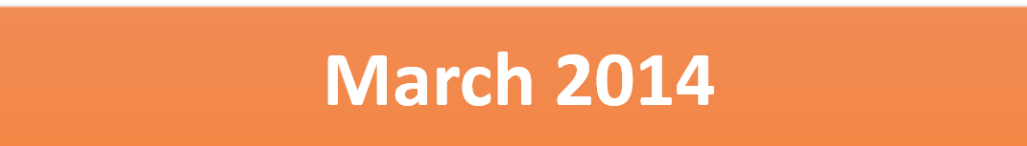
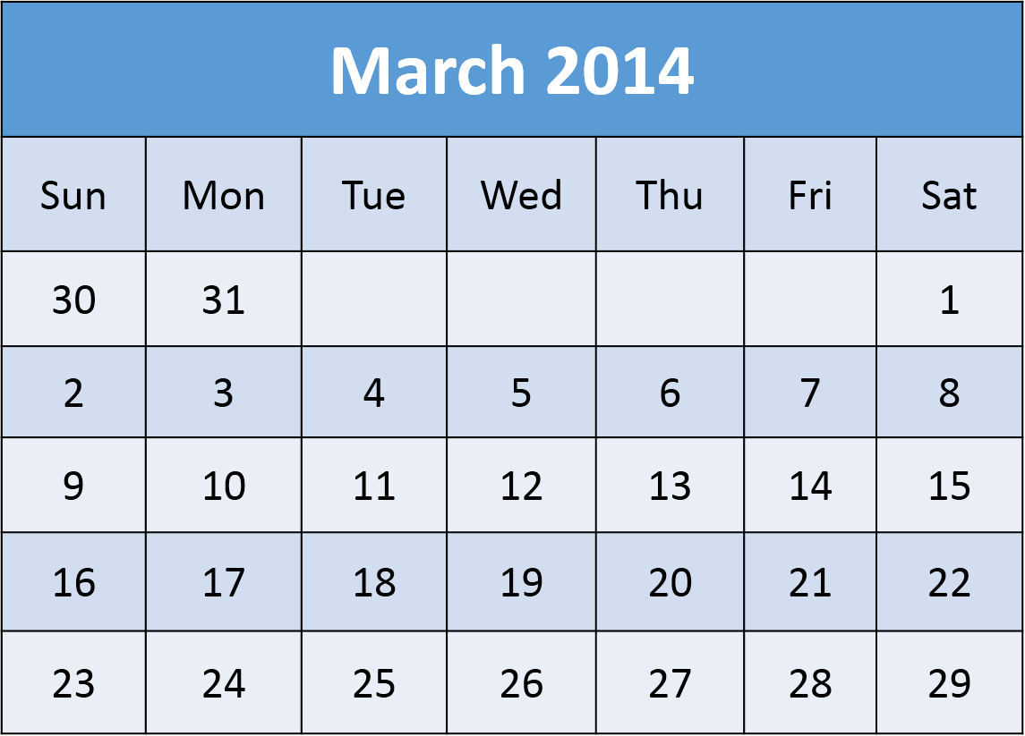
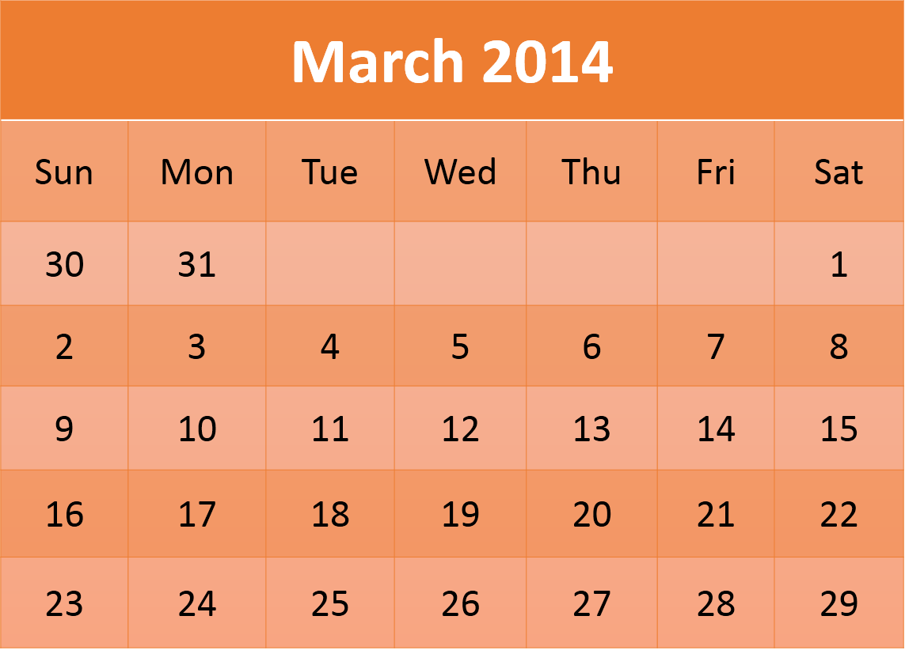
Java 8 is a major update that was launched on

Slide 3
The Java programming language is a high-level language that has following features:
Simple
No Pointers, No Multiple Inheritance
Platform Independent
Compile once run anywhere
Object Oriented
Strong Object Oriented Language,
No Global Variable, No Friend Function
Portable
Data types occupy same no. of bytes on all platforms
Distributed
Client Server Application can be made effectively

Slide 4
High Performance
Due to JIT, execution becomes faster
Multithreaded
You can create Multithreaded Applications
Robust
Safe, most of the things are checked during compile time so no risk at runtime
Dynamic
Supports late binding since beginning. You can load any class on the fly and find out its information.
Secure
If bytecode contains virus or malicious code , it cannot be executed on the system. Thanks to Java’s secure feature.

Slide 5
In the Java programming language, all source code is first written in plain text files ending with the .java extension.
Those source files are then compiled into
.class files by the javac compiler.

Slide 6
A .class file does not contain code that is native to your processor; it instead contains bytecodes — the machine language of the Java Virtual Machine (Java VM).
The java launcher tool (JRE) then runs your application with an instance of the Java Virtual Machine.

Slide 7
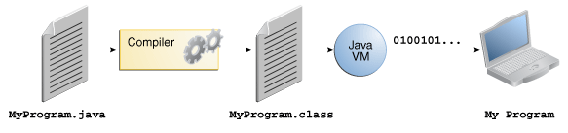
An overview of the software development process

Slide 8
Because the Java VM is available on many different operating systems, the same .class files are capable of running on Microsoft Windows, the Solaris™ Operating System (Solaris OS), Linux, or Mac OS.

Slide 9
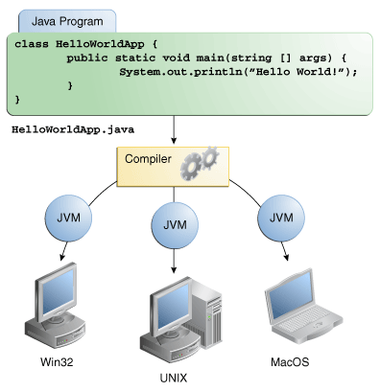
Through the Java VM, the same application is capable of running on multiple platforms.

Slide 10
The Java Platform
A platform is
the hardware or software environment in which a program runs.
Some of the most popular platforms are
Microsoft Windows, Linux, Solaris OS, and Mac OS.
Most platforms can be described as a
combination of the operating system and underlying hardware.

Slide 11
The Java platform differs from most other platforms in that it's a software-only platform that runs on top of other hardware-based platforms.

Slide 12
The Java Virtual Machine
(JVM)
The Java Application Programming Interface
(API)
OS and hardware based Platform
[Windows, Linux,Mac etc.]

Slide 13
The Java Virtual Machine (JVM)
Java Virtual Machine (JVM) is the base for the Java platform and is ported onto various hardware-based platforms.
The Java Application Programming Interface (API)
The API is a large collection of ready-made software components that provide many useful capabilities. It is grouped into libraries of related classes and interfaces; these libraries are known as packages.
API mainly consists of jar and dll files.

Slide 14
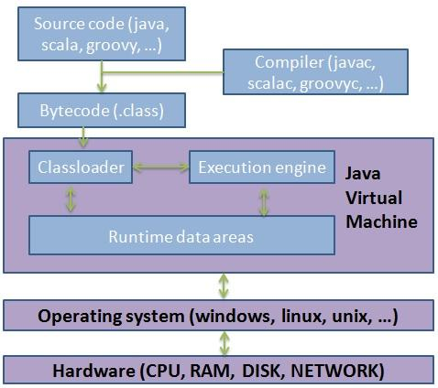
The API and Java Virtual Machine insulate the program from the underlying hardware.

